Slide 1
Arthur Miller’s Death of a Salesman as a critique of the American Dream
-Lakshmi Muthukumar, Ph.D.

Slide 2
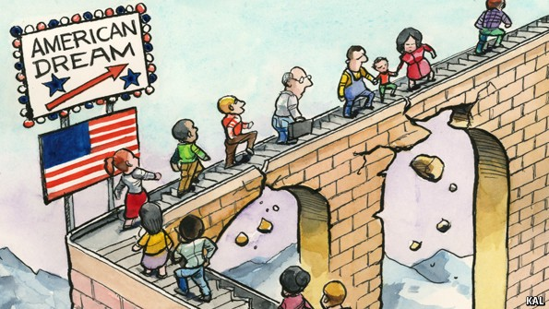
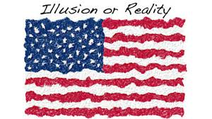
What is the American Dream?

Slide 3
The American Dream is the belief that anyone, regardless of where they were born or what class they were born into, can attain their own version of success in a society where upward mobility is possible for everyone.
The American Dream is achieved through sacrifice, risk-taking, and hard work, rather than by chance.

Slide 4
The Ideal American Dream
The ideal by which equality of opportunity is available to any American, allowing the highest aspirations and goals to be achieved.
In the 1920s, the American Dream started morphing from the right to create a better life to the desire to acquire material things. This change was described by F. Scott Fitzgerald in his novel The Great Gatsby.

Slide 5
The phrase was coined by James Truslow Adams in his historical work The Epic of America (1931).
The phrase originally referred to a “dream of a land in which life should be better and richer and fuller for every man, with opportunity for each according to his ability or achievement”.

Slide 6
The American Notion of Success
America’s traditional definition of success is often thought to be associated with wealth, power and position. A study commissioned by Strayer University found that 90 percent of Americans define success as attaining personal goals and having good relationships with family and friends.

Slide 7
Others believe that the idea first came from James Adams, a noted American writer and historian and the phrase is defined as an idea which believes that all people have the possibility of prosperity and success.

